Slide 1

Pandora: AI Counselor Bot
Developed by
Michelle De Melo
Radhika Dabholkar

Slide 2

Abstract
Purpose
Focus
An AI counselor providing emotional support to students.
Helps with stress, loneliness, anxiety, and depression.
Approach
Combines Retrieval-Augmented Generation and optional fine-tuning.

Slide 3

Problem Statement
Challenges
Issues
Failure in handling sensitive conversations effectively.
Tendency to hallucinate inaccurate or harmful advice.
User Experience
Responses often sound robotic or emotionally distant.

Slide 4



Objective
2
Accuracy
Guarantee factual and safe responses for users.
Empathy
Provide warm, understanding support in conversations.
1
Sensitivity
Handle emotional topics with care and respect.
3

Slide 5





Technologies Used
Python 3.10
HuggingFace Transformers
FAISS
Jupyter Notebook
Programming and AI model implementation language.
Efficient similarity search and retrieval.
State-of-the-art NLP model frameworks.
Interactive coding and experimentation environment.

Slide 6
System Architecture
User Input
Initial message submitted by user.
RAG Search
Retrieve relevant contextual information.
Warm Prompt
Generate empathetic prompt for response.
Fine-tuned Model
Produce accurate, safe reply.
Final Reply
Deliver thoughtful response to user.

Slide 7

Methodology
1
Prompt Engineering
Crafting context-aware prompts for better AI responses.
2
RAG Utilization
Integrating real-world data to improve relevance.
3
Fine-Tuning
Optional adaptation for enhanced empathy and accuracy.
4
Fallback
Use pure RAG retrieval if fine-tuning unavailable.

Slide 8
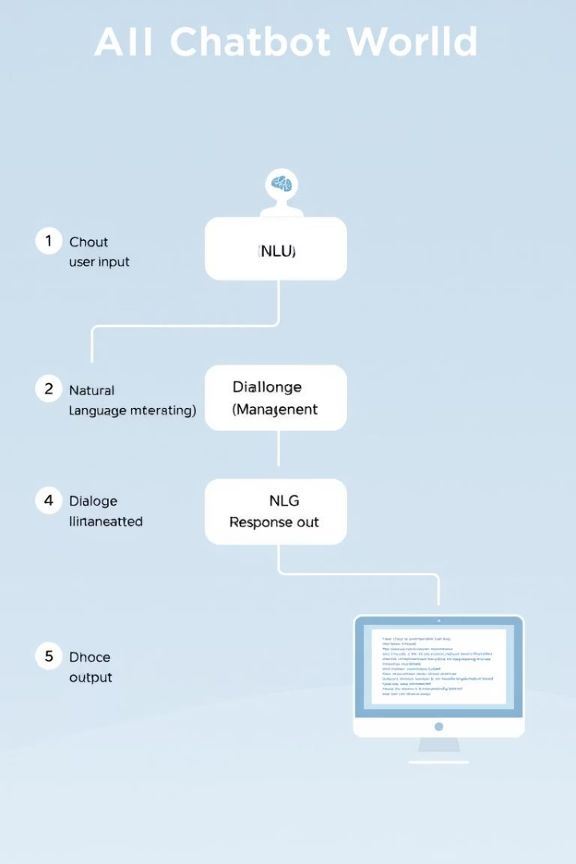
Workflow Diagram
1
User Sends Input
User types and submits emotional message.
2
FAISS Search
Retrieve closest matching support content.
3
Optional Rewrite
Fine-tuned model refines response if enabled.
4
Final Response
Chatbot delivers empathetic and safe reply.

Slide 9
Sample Chat Outputs
User:
Pandora:
I feel sad.
It's okay to feel sad. I'm here to listen.
I'm anxious.
Anxiety is normal. Deep breaths.
I feel like ending it.
Please reach out to someone you trust.

Slide 10

Conclusion
Emotional Safety
Hybrid Architecture
Pandora ensures secure handling of sensitive chats.
Combines retrieval and fine-tuning for factual replies.
Scalability
Designed to grow with future demands and features.

